Slide 1
CASE STUDY • Q1 2016
BrightTV Viewership
Insights & Recommendations
A data-driven look at audience, channels, and growth opportunities
Prepared for the Executive Team
Data window: 2016-01-01 – 2016-03-31 • 10,000 viewing sessions analyzed

Slide 2
CONTENTS
What we will cover
01
Executive Summary
Headline numbers and key takeaways
02
Methodology
Data sources, scope, and approach
03
Audience Profile
Who is watching BrightTV
04
When People Watch
Time-of-day, weekday, and monthly patterns
05
Channel Performance
Top performers and underperformers
06
Recommendations
Strategic actions to grow viewership
07
Next Steps
Roadmap for execution
BrightTV Analytics • Agenda
2 / 16

Slide 3
01 • EXECUTIVE SUMMARY
The story in one slide
10,000
4,386
1,523.1h
21
Viewing sessions
Unique viewers
Total watch time
Channels tracked
KEY TAKEAWAYS
Sport dominates — Supersport Live Events + ICC Cricket = 31% of all views
Audience grew 119% from January (2,203) to March (4,821) — strong momentum
Skewed audience: 90% male, 41.5% aged 25-34, 38% from Gauteng
Mornings (5-12) lead viewing (3,383 views) — not the assumed evening slot
10 channels capture ~85% of views; 8 channels barely register (<120 views each)
BrightTV Analytics • Executive Summary
3 / 16

Slide 4
02 • METHODOLOGY
How we approached the analysis
1
2
3
4
COLLECT
TRANSFORM
ANALYZE
VISUALIZE
Two source files:
Viewership log (10K rows)
User profiles (5,375 rows)
Joined on UserID
Derived hour, day-of-week,
time bucket, age group
Aggregated by channel,
time, demographics
using Python / pandas
Built charts and KPI cards
to surface patterns and
opportunities for the CEO
DATA QUALITY NOTE
All 10,000 viewing sessions matched to a user profile (100% join rate). The dataset spans Q1 2016 (Jan–Mar). Gender skew (90% male) likely reflects the sport-heavy programming mix and should inform — not bias — interpretation.
BrightTV Analytics • Methodology
4 / 16

Slide 5
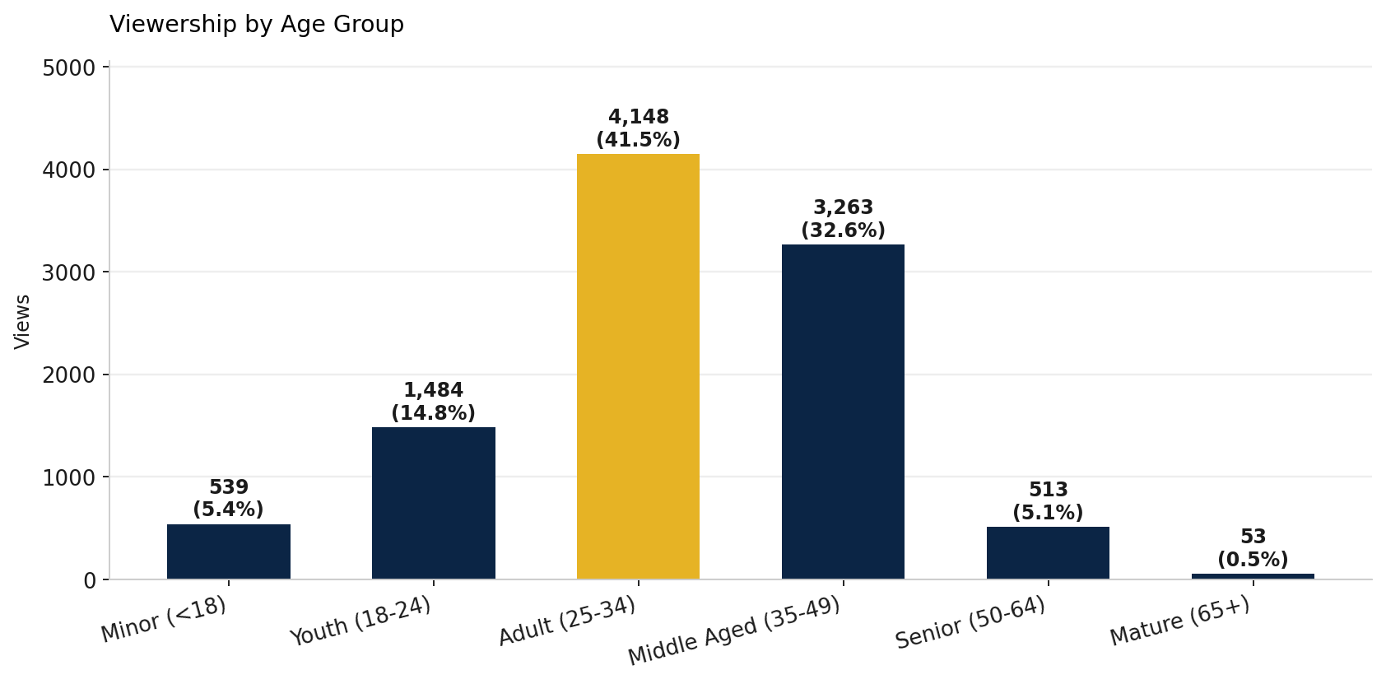
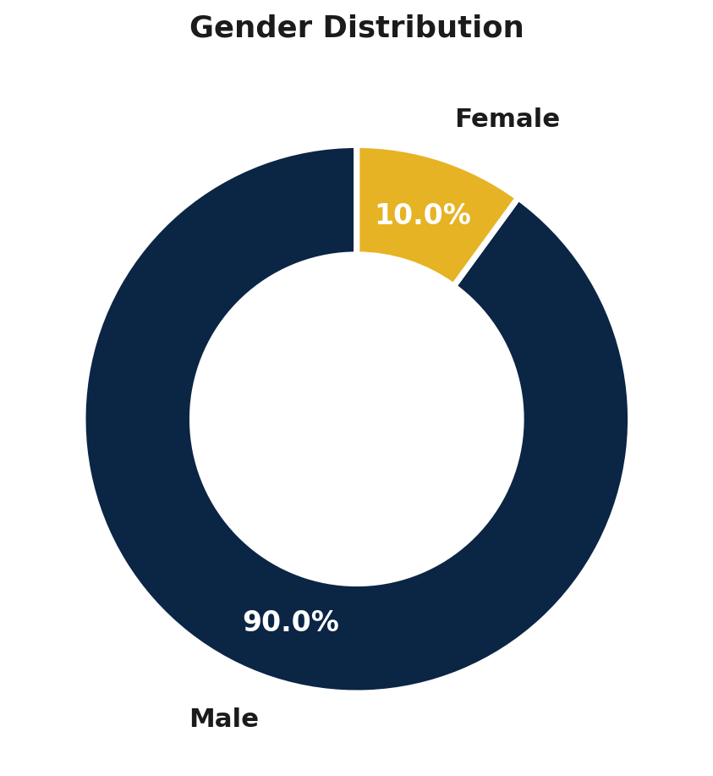
03 • AUDIENCE PROFILE
Age and gender breakdown
INSIGHT
Adults 25–34 are the core audience (41.5%). The 90% male skew is the single biggest opportunity to diversify reach.
BrightTV Analytics • Audience
5 / 16

Slide 6
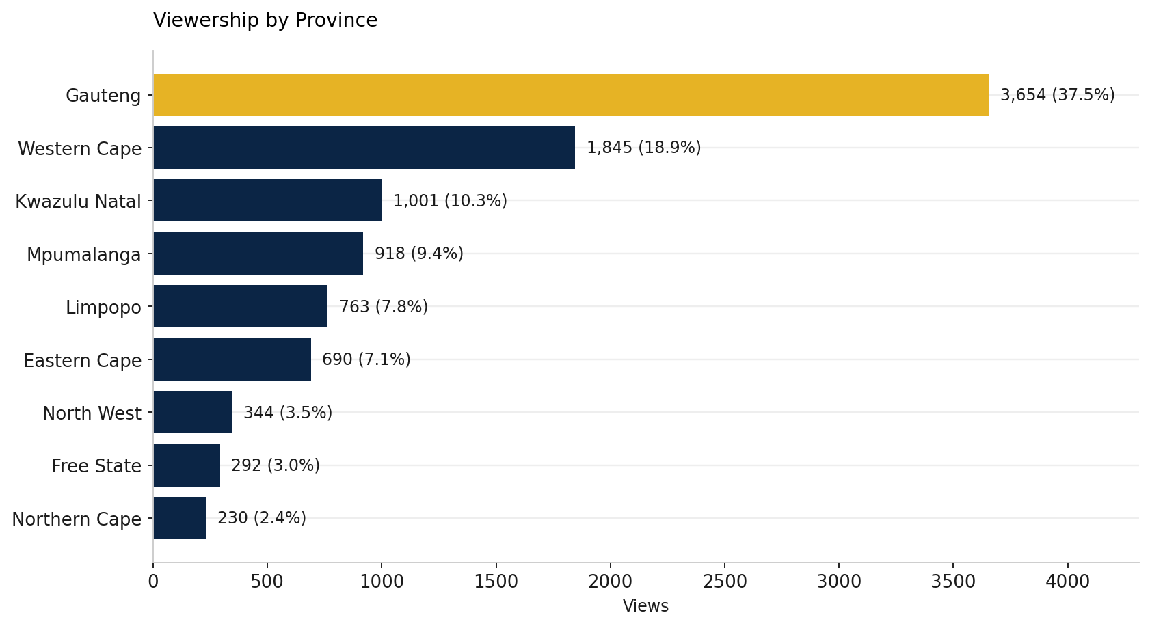
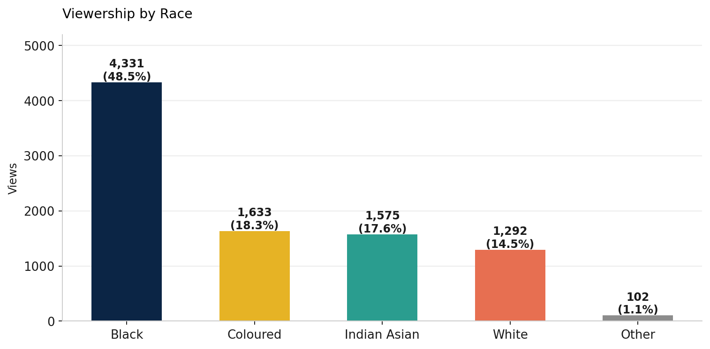
03 • AUDIENCE PROFILE
Geographic & demographic distribution
INSIGHT
Gauteng + Western Cape = 56% of viewership. Six provinces are under-served — a clear regional growth target.
BrightTV Analytics • Audience
6 / 16

Slide 7
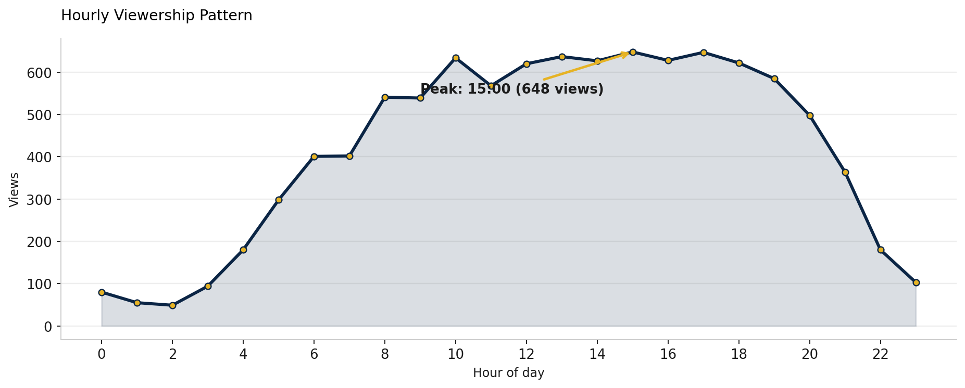
04 • WHEN PEOPLE WATCH
Hourly viewership pattern
INSIGHT
Viewing peaks at 15:00 with sustained activity from late morning through afternoon — atypical for traditional TV.
BrightTV Analytics • When People Watch
7 / 16

Slide 8
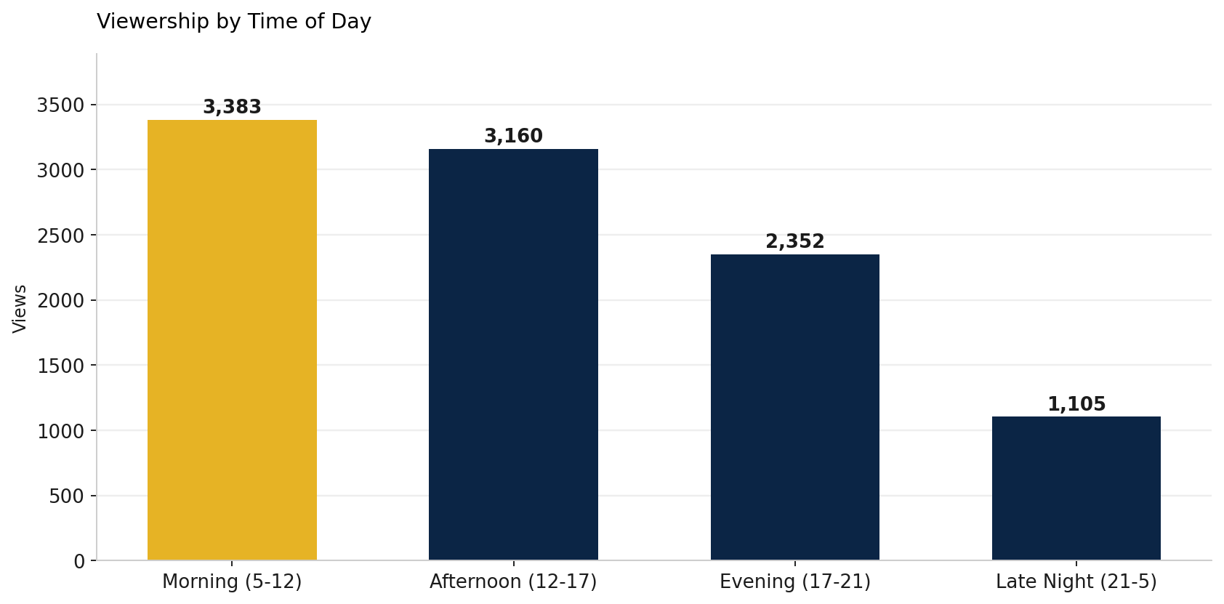
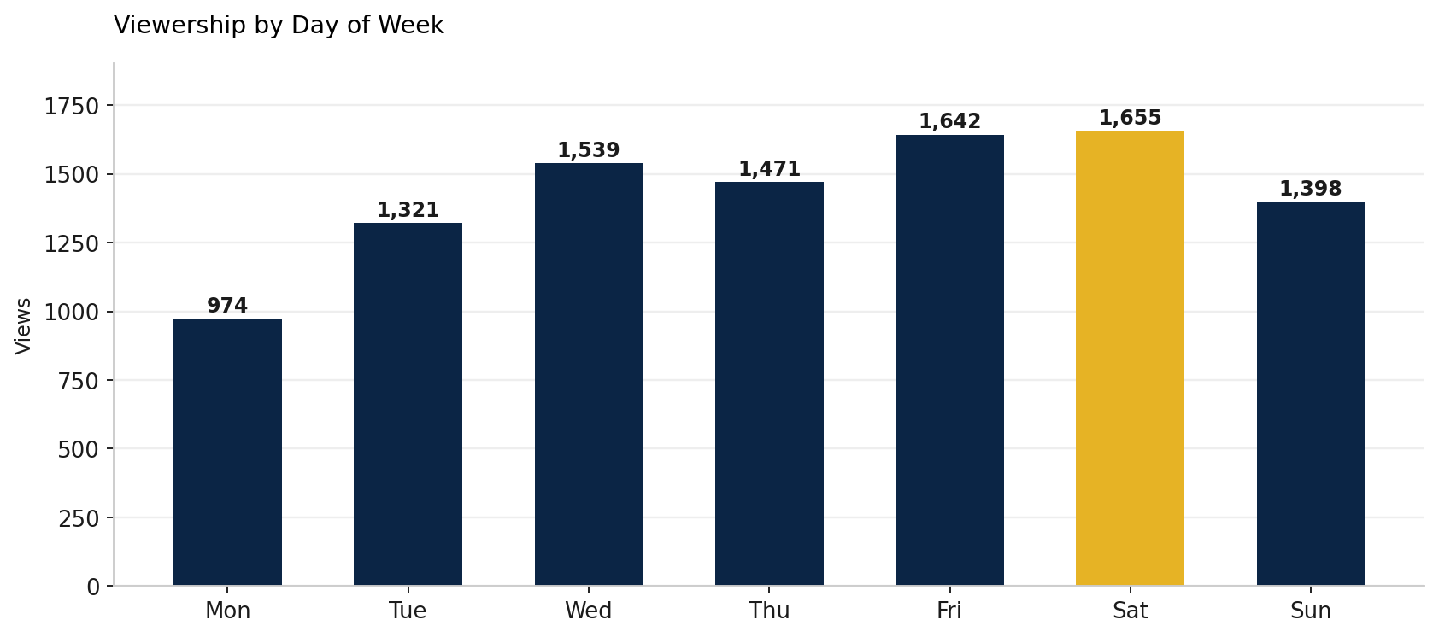
04 • WHEN PEOPLE WATCH
Time of day and day of week
INSIGHT
Saturdays drive the most views (1,655). Weekday viewership grows through the week, dipping on Mondays.
BrightTV Analytics • When People Watch
8 / 16

Slide 9
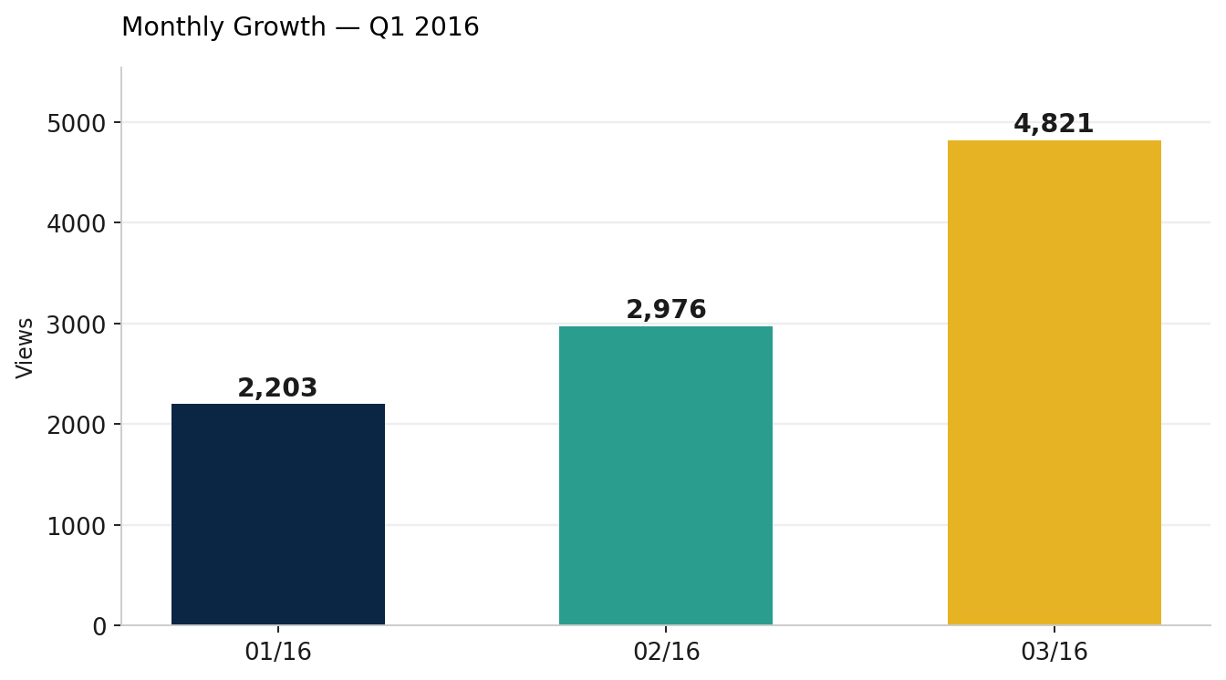
04 • WHEN PEOPLE WATCH
Monthly growth — strong upward trend
Q1 GROWTH
+119%
January → March
PEAK MONTH
March 2016
4,821 views (48% of Q1)
INSIGHT
Growth coincides with the ICC Cricket World Cup period — major sporting events are a primary acquisition driver.
BrightTV Analytics • Growth Trajectory
9 / 16

Slide 10
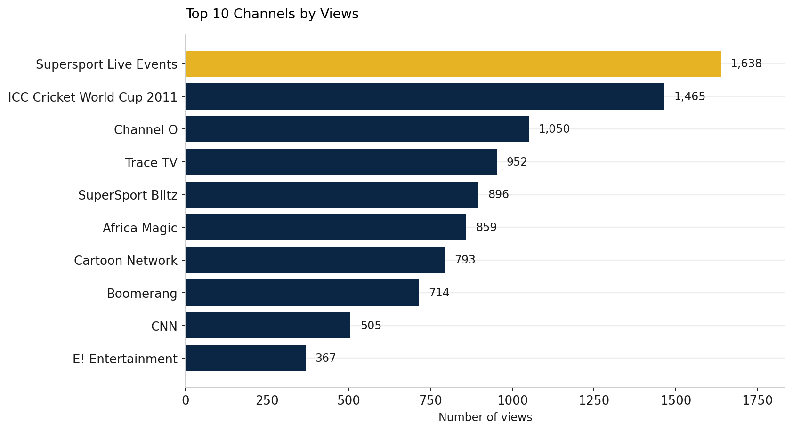
05 • CHANNEL PERFORMANCE
Top 10 channels — sport leads the pack
#1 CHANNEL
Supersport
Live Events
1,638 views
16.4% of all viewing
SPORT TOTAL
41.2%
of all viewing time
BrightTV Analytics • Channel Performance
10 / 16

Slide 11
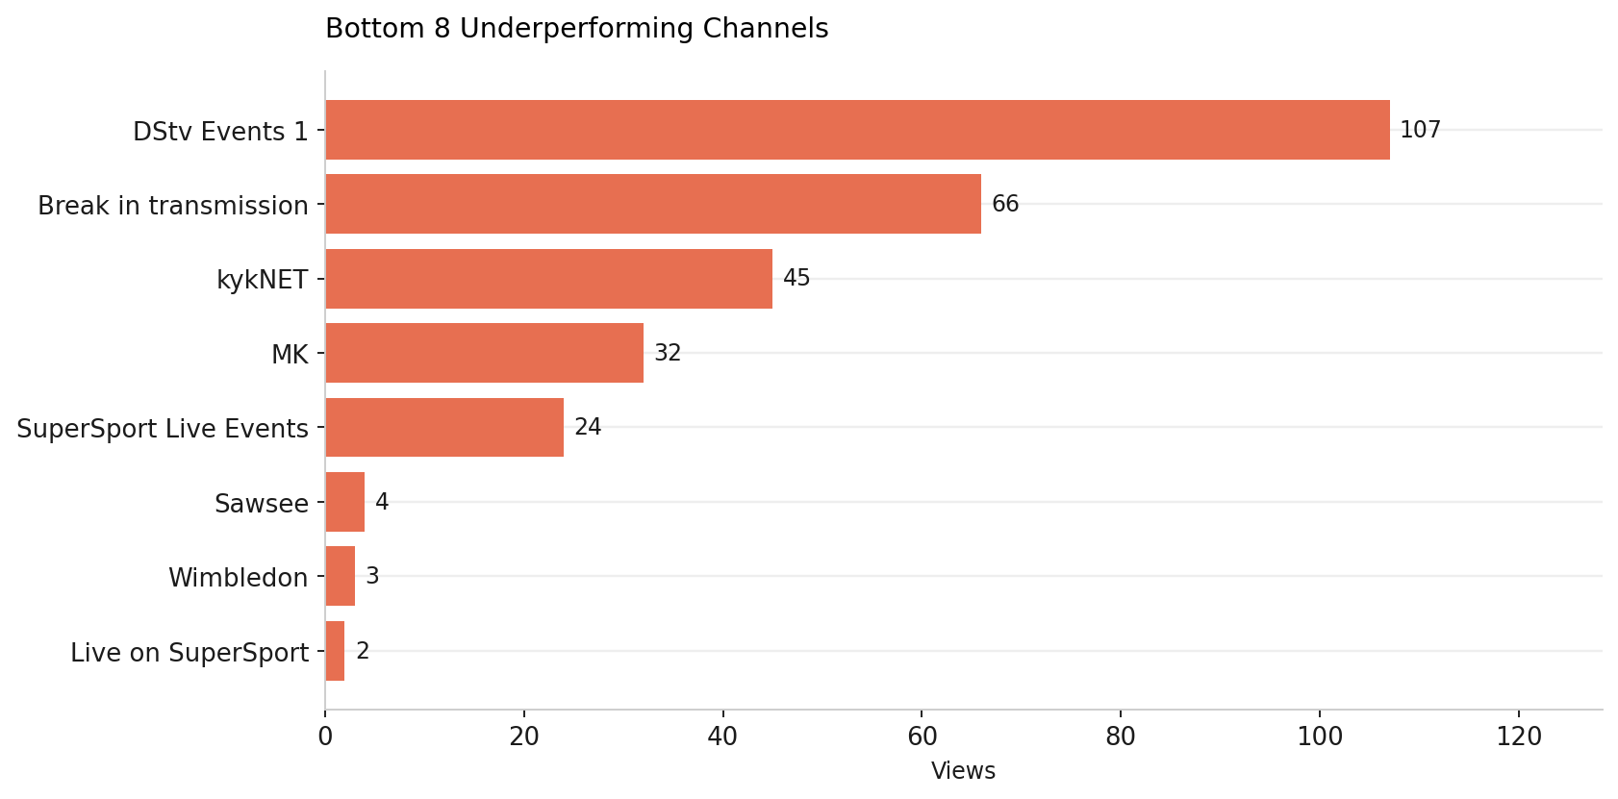
05 • CHANNEL PERFORMANCE
Underperforming channels — long tail risk
LONG TAIL
8 channels
<120 views each
COMBINED SHARE
~5%
These channels consume
bandwidth and licensing
budget without driving
meaningful viewership.
OPPORTUNITY
Re-evaluate or replace bottom channels — reinvest spend into top performers and audience-diversification content.
BrightTV Analytics • Channel Performance
11 / 16

Slide 12
PART 06
Recommendations
Five strategic moves to grow viewership in the next two quarters

Slide 13
06 • RECOMMENDATIONS
Five strategic priorities
1
DOUBLE DOWN ON SPORT
Secure rights to more live sport events. They drove the +119% Q1 surge and command 41% of viewing.
2
DIVERSIFY THE AUDIENCE
Female viewers are only 10%. Commission lifestyle, drama, and reality content to broaden appeal.
3
GO REGIONAL
Six provinces under-index. Localise marketing campaigns for KZN, Mpumalanga, Limpopo and Eastern Cape.
4
DAYTIME PROGRAMMING
Mornings and afternoons drive 65% of views. Strengthen daytime line-up rather than only prime-time.
5
TRIM THE LONG TAIL
Drop or renegotiate 8 channels with <120 views and reinvest in top-10 channel quality.
BrightTV Analytics • Recommendations
13 / 16

Slide 14
06 • RECOMMENDATIONS
Impact vs effort — where to start
Initiative
Impact
Effort
Timeline
Priority
Double down on sport
High
Medium
0-3 months
P0
Trim long-tail channels
Medium
Low
0-3 months
P0
Strengthen daytime line-up
High
Medium
3-6 months
P1
Diversify audience content
High
High
3-9 months
P1
Regional marketing campaigns
Medium
Medium
3-6 months
P2
P0 = ship this quarter • P1 = next two quarters • P2 = within the year
BrightTV Analytics • Prioritization
14 / 16

Slide 15
07 • NEXT STEPS
From insight to action
THIS WEEK
Approve recommendations
CEO + leadership team align on P0 initiatives and budget envelope.
30 DAYS
Operationalise reporting
Automate daily viewership dashboards; define KPIs and channel scorecard.
60 DAYS
Launch sport rights review
Identify additional live sport opportunities for Q3/Q4 acquisition.
90 DAYS
Pilot diversification content
Commission 2–3 lifestyle/drama pilots targeting female 25–34 segment.
BEYOND Q3 — STRATEGIC TRACK
Loyalty programme tied to peak time slots • Multi-region rollout tracking • Personalised content recommendations
BrightTV Analytics • Next Steps
15 / 16

Slide 16
Thank you.
Questions and discussion
BrightTV Analytics • Q1 2016 Review
Prepared by the Data Analytics team

